Slide 1
ERD/Constraints in DBMS & Foreign Key Relationships
Understanding Constraints, Parent-Child Tables, and Cascading Effects

Slide 2
What is an ER Model?
An Entity-Relationship Model represents the structure of the database with the help of a diagram. ER Modelling is a systematic process to design a database as it would require you to analyze all data requirements before implementing your database.
History of ER models
Peter Chen proposed ER Diagrams in 1971 to create a uniform convention that can be used as a conceptual modeling tool. Many models were presented and discussed, but none were suitable. The data structure diagrams offered by Charles Bachman also inspired his model.

Slide 3
Why Use ER Diagrams in DBMS?
ER Diagram helps you conceptualize the database and lets you know which fields need to be embedded for a particular entity
ER Diagram gives a better understanding of the information to be stored in a database
It reduces complexity and allows database designers to build databases quickly
It helps to describe elements using Entity-Relationship models
It allows users to get a preview of the logical structure of the database

Slide 4
Symbols Used in ER Diagrams
Rectangles: This Entity Relationship Diagram symbol represents entity types
Ellipses: This symbol represents attributes
Diamonds: This symbol represents relationship types
Lines: It links attributes to entity types and entity types with other relationship types
Primary key: Here, it underlines the attributes
Double Ellipses: Represents multi-valued attributes

Slide 5
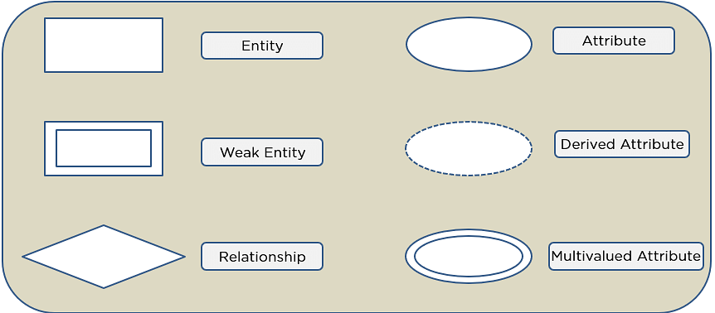

Slide 6
Components of ER Diagram
ER Diagram on three basic concepts:
Entities
Weak Entity
Attributes
Key Attribute
Composite Attribute
Multivalued Attribute
Derived Attribute
Relationships
One-to-One Relationships
One-to-Many Relationships
Many-to-One Relationships
Many-to-Many Relationships

Slide 7
Entities/Weak Entities
An entity can be either a living or non-living component.
It showcases an entity as a rectangle in an ER diagram.
For example, in a student study course, both the student and the course are entities.
Weak Entity
An entity that makes reliance over another entity is called a weak entity
You showcase the weak entity as a double rectangle in ER Diagram.
In the example below, school is a strong entity because it has a primary key attribute - school number. Unlike school, the classroom is a weak entity because it does not have any primary key and the room number here acts only as a discriminator.

Slide 8
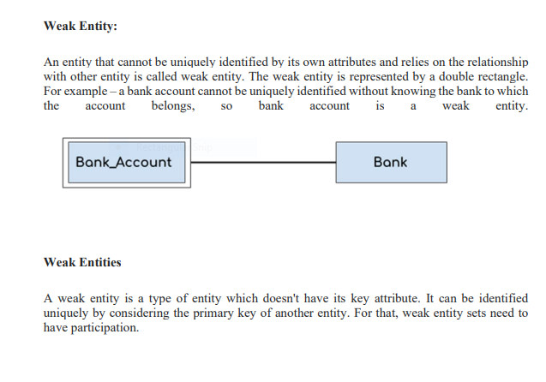

Slide 9
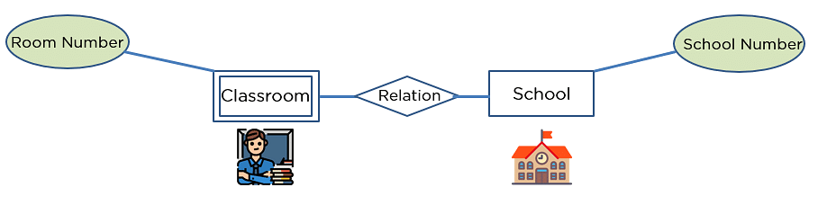
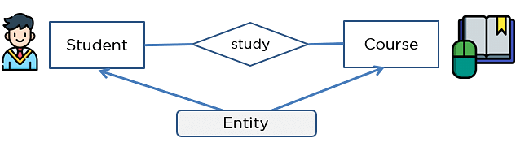

Slide 10
Attribute
An attribute exhibits the properties of an entity.
You can illustrate an attribute with an oval shape in an ER diagram.
Key Attribute
Key attribute uniquely identifies an entity from an entity set.
It underlines the text of a key attribute.
For example: For a student entity, the roll number can uniquely identify a student from a set of students.

Slide 11
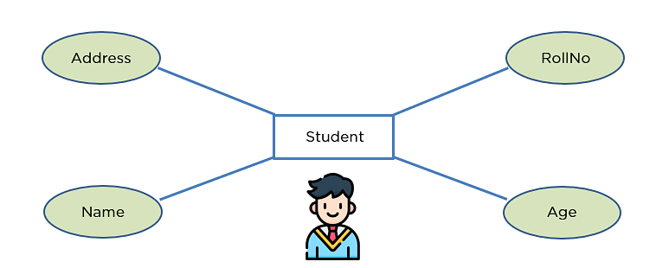

Slide 12
Composite Attribute
An attribute that is composed of several other attributes is known as a composite attribute.
An oval showcases the composite attribute, and the composite attribute oval is further connected with other ovals.
Multivalued Attribute
Some attributes can possess over one value, those attributes are called multivalued attributes.
The double oval shape is used to represent a multivalued attribute.
Derived Attribute
An attribute that can be derived from other attributes of the entity is known as a derived attribute.
In the ER diagram, the dashed oval represents the derived attribute.

Slide 13
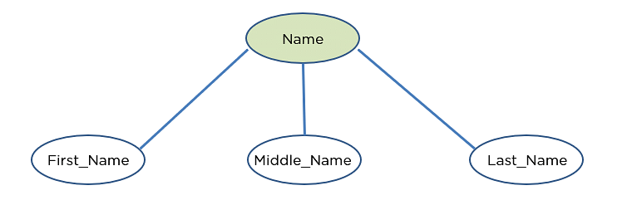
Composite Attribute

Slide 14
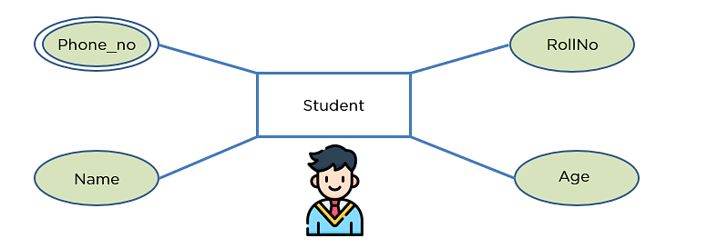
Multivalued

Slide 15
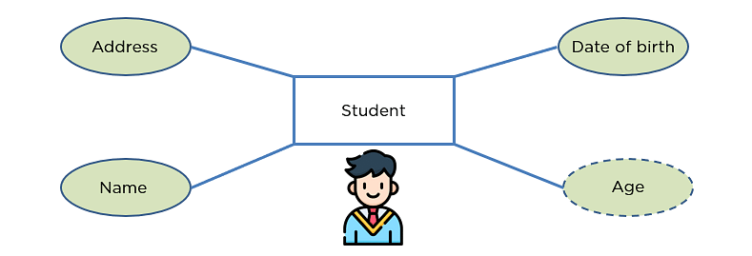
Derived

Slide 16
Relationship
The diamond shape showcases a relationship in the ER diagram.
It depicts the relationship between two entities.
In the example below, both the student and the course are entities, and study is the relationship between them.
One-to-One Relationship
When a single element of an entity is associated with a single element of another entity, it is called a one-to-one relationship.
For example, a student has only one identification card and an identification card is given to one person.
One-to-Many Relationship
When a single element of an entity is associated with more than one element of another entity, it is called a one-to-many relationship
For example, a customer can place many orders, but an order cannot be placed by many customers.
Many-to-One Relationship
When more than one element of an entity is related to a single element of another entity, then it is called a many-to-one relationship.
For example, students have to opt for a single course, but a course can have many students.

Slide 17



Slide 18
How to Draw an ER Diagram?
Below are some important points to draw ER diagram:
First, identify all the Entities. Embed all the entities in a rectangle and label them properly.
Identify relationships between entities and connect them using a diamond in the middle, illustrating the relationship. Do not connect relationships with each other.
Connect attributes for entities and label them properly.
Eradicate any redundant entities or relationships.
Make sure your ER Diagram supports all the data provided to design the database.
Effectively use colors to highlight key areas in your diagrams.

Slide 19


1:1,1:m,m:1Relation ship

Slide 20
CASE1: For Strong Entity Set
A strong entity set having only simple attributes or composite attributes will require only one table in the relational model.
The simple attribute of the table will be the attribute of the entity set. Simple attributes of the composite attributes are considered and not composite attributes themselves.
The primary key of the resulting table will be the key attribute of the entity set. Examples

Slide 21
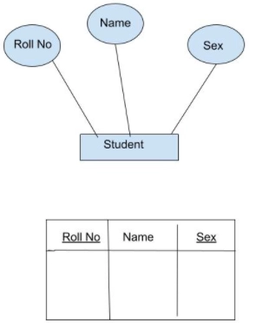

Slide 22
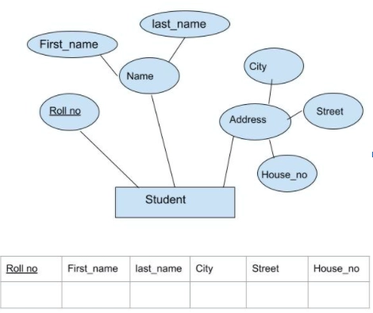
Composite Attribute Representation

Slide 23
CASE 2: For Strong Entity Set With Multi-Valued Attributes
A strong entity set having any number of multi-valued attributes will require two tables in the relational model.
One table will consist of all the simple attributes with the primary key.
Another table will contain the primary key and all the multi-valued attributes.
Example
In this example, Mobile_no is a multivalued attribute. Here, Roll_no is the primary key. So we made a table using primary key Roll_no and remaining simple attributes and other tables having attributes Roll_no and Mobile_no.

Slide 24
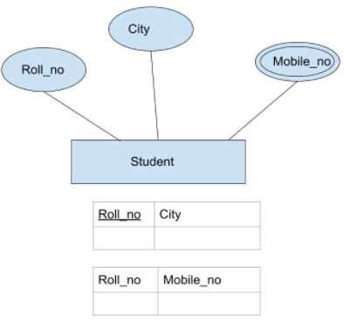
Multivalued Representation

Slide 25
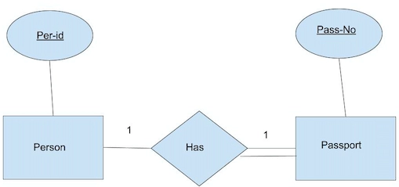
CASE 3: Binary Relationship with 1:1 cardinality with the total participation of an entity

Slide 26
In this example, a person can have 0 or 1 passport number. A single person owns each passport shown., So it is one-to-one (1:1) cardinality with the full participation of the Passport entity.
Firstly, we will convert every entity and relationship to tables. We have three tables corresponding to two entities and one for the relation between the entities. Person table and Passport table correspond to Person and Passport entity respectively. The Has table shows the relationship between Passport and Person table. So it will take attribute Per-Id from Person and Pass-No from Passport.

Slide 27
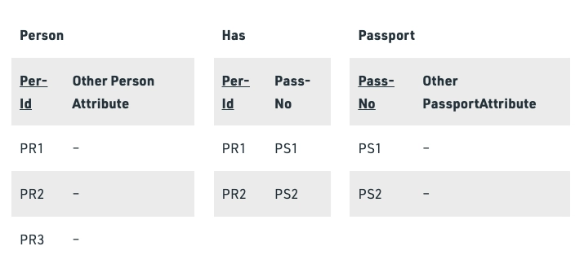

Slide 28
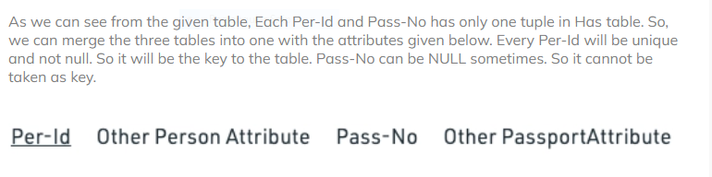

Slide 29
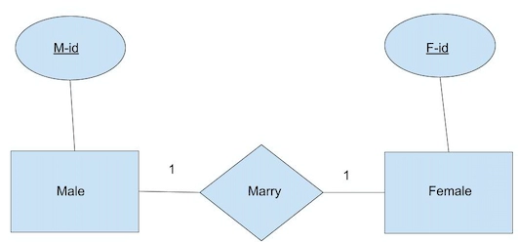
CASE 4: Binary Relationship with 1:1 cardinality and partial participation of both entities

Slide 30
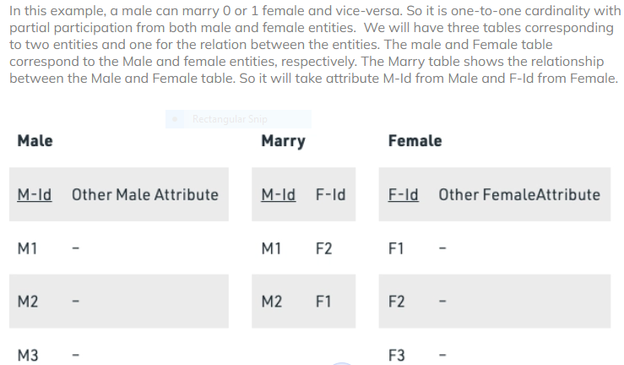

Slide 31
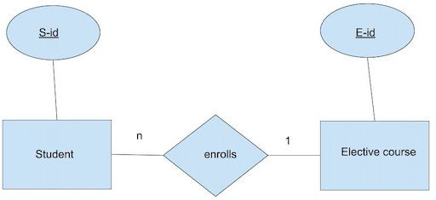
CASE 5: Binary Relationship having n: 1 cardinality

Slide 32


Slide 33
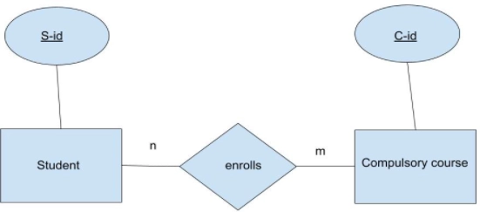
CASE 6: Binary Relationship having m: n cardinality

Slide 34


Slide 35
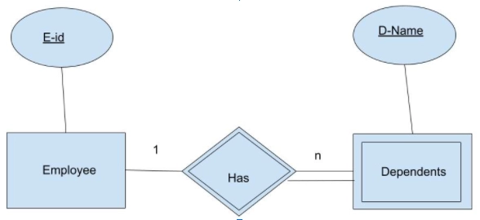
CASE 7: Binary Relationship having a weak entity

Slide 36
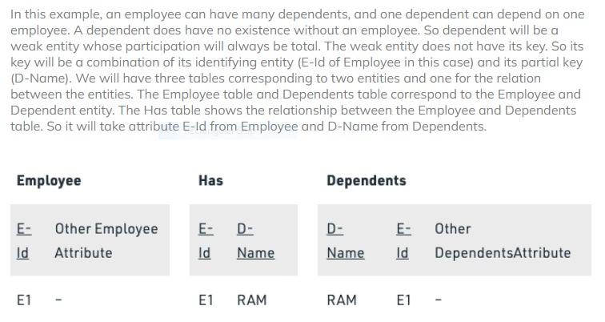

Slide 37
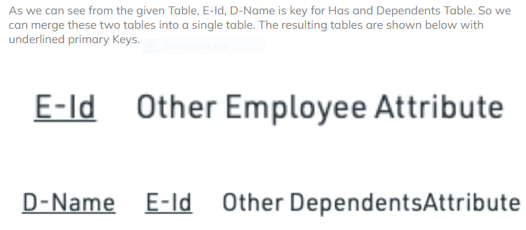

Slide 38
Introduction to Constraints in DBMS
Constraints ensure data integrity and accuracy in databases.
They impose rules on table columns to restrict invalid data entry.
Types of constraints: NOT NULL, UNIQUE, PRIMARY KEY, FOREIGN KEY, CHECK, DEFAULT.

Slide 39
NOT NULL Constraint
Ensures that a column cannot have NULL values.
Example:
CREATE TABLE Students (
StudentID INT PRIMARY KEY,
Name VARCHAR(50) NOT NULL
);

Slide 40
UNIQUE Constraint
Ensures all values in a column are unique.
Example:
CREATE TABLE Employees (
EmpID INT PRIMARY KEY,
Email VARCHAR(100) UNIQUE
);

Slide 41
PRIMARY KEY Constraint
Uniquely identifies each record in a table.
Example:
CREATE TABLE Courses (
CourseID INT PRIMARY KEY,
CourseName VARCHAR(50) NOT NULL
);

Slide 42
FOREIGN KEY Constraint
Links two tables to enforce referential integrity.
Example:
CREATE TABLE Enrollments (
EnrollmentID INT PRIMARY KEY,
StudentID INT,
FOREIGN KEY (StudentID) REFERENCES Students(StudentID)
);

Slide 43
Parent and Child Table Concept in Foreign Key
A Foreign Key creates a relationship between two tables, forming a Parent-Child relationship.
Parent Table: The table that contains the Primary Key (Referenced Table).
Child Table: The table that contains the Foreign Key (Referencing Table).
Example:
Consider a Students table as the Parent Table and an Enrollments table as the Child Table.

Slide 44
Example:-
CREATE TABLE Students (
StudentID INT PRIMARY KEY,
Name VARCHAR(50) NOT NULL
);
CREATE TABLE Enrollments (
EnrollmentID INT PRIMARY KEY,
StudentID INT,
CourseName VARCHAR(50),
FOREIGN KEY (StudentID) REFERENCES Students(StudentID)
);

Slide 45
CHECK Constraint
Ensures values meet a specified condition.
Example:
CREATE TABLE Products (
ProductID INT PRIMARY KEY,
Price DECIMAL(10,2) CHECK (Price > 0)
);

Slide 46
DEFAULT Constraint
Sets a default value for a column.
Example:
CREATE TABLE Orders (
OrderID INT PRIMARY KEY,
OrderDate DATE DEFAULT CURRENT_DATE
);

Slide 47
Parent and Child Tables in Foreign Key
Parent Table: Contains the primary key.
Child Table: Contains the foreign key referencing the parent table.

Slide 48
Cascading Effects in Foreign Key
ON DELETE CASCADE: Deletes child records when parent record is deleted.
ON DELETE SET NULL: Sets child records' foreign key to NULL.
ON DELETE RESTRICT: Prevents deletion if related child records exist.
ON UPDATE CASCADE: Updates child records when parent key changes.

Slide 49
Example of ON DELETE CASCADE
Example:
CREATE TABLE Enrollments (
EnrollmentID INT PRIMARY KEY,
StudentID INT,
FOREIGN KEY (StudentID) REFERENCES Students(StudentID) ON DELETE CASCADE
);

Slide 50
Example of ON DELETE SET NULL
Example:
CREATE TABLE Enrollments (
EnrollmentID INT PRIMARY KEY,
StudentID INT,
FOREIGN KEY (StudentID) REFERENCES Students(StudentID) ON DELETE SET NULL
);

Slide 51
Example of ON DELETE RESTRICT
Example:
CREATE TABLE Enrollments (
EnrollmentID INT PRIMARY KEY,
StudentID INT,
FOREIGN KEY (StudentID) REFERENCES Students(StudentID) ON DELETE RESTRICT
);

Slide 52
Example of ON UPDATE CASCADE
Example:
CREATE TABLE Enrollments (
EnrollmentID INT PRIMARY KEY,
StudentID INT,
FOREIGN KEY (StudentID) REFERENCES Students(StudentID) ON UPDATE CASCADE
);

Slide 53
Conclusion
Constraints maintain data integrity and relationships.
Foreign keys establish parent-child relationships.
Cascading effects help automate updates and deletions.
Use constraints wisely to ensure efficient database management.

Slide 54
Q&A
Thank you! Any questions?

Slide 55


Slide 56


Slide 57
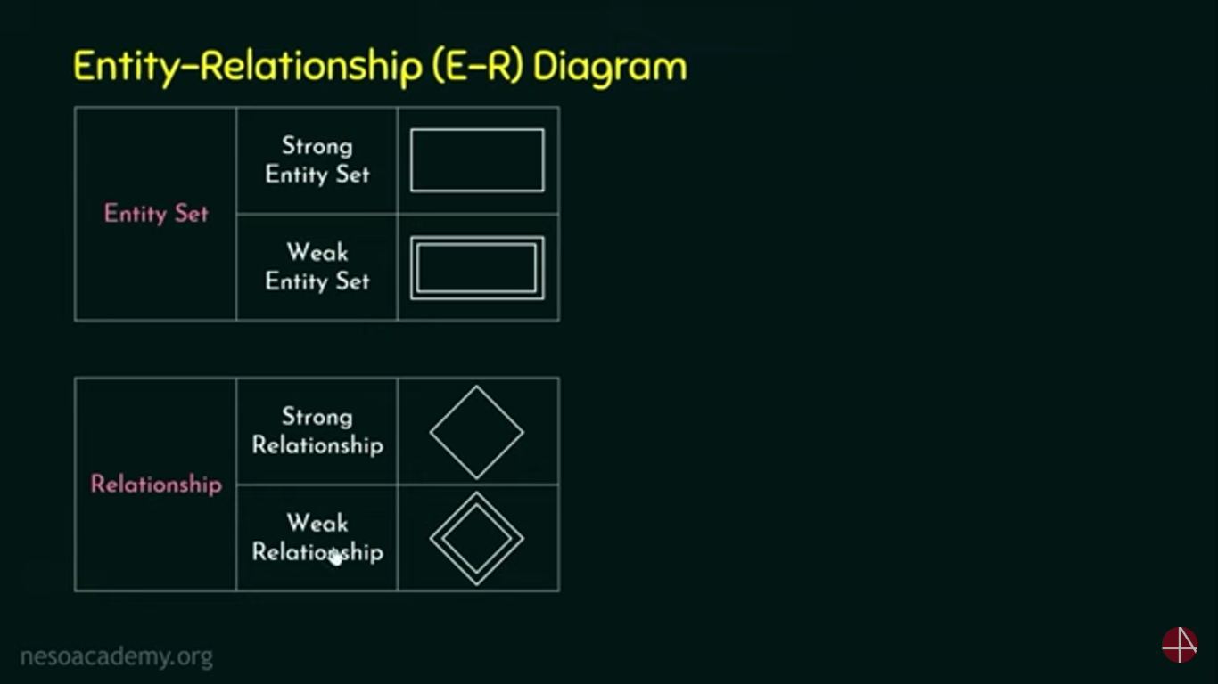

Slide 58
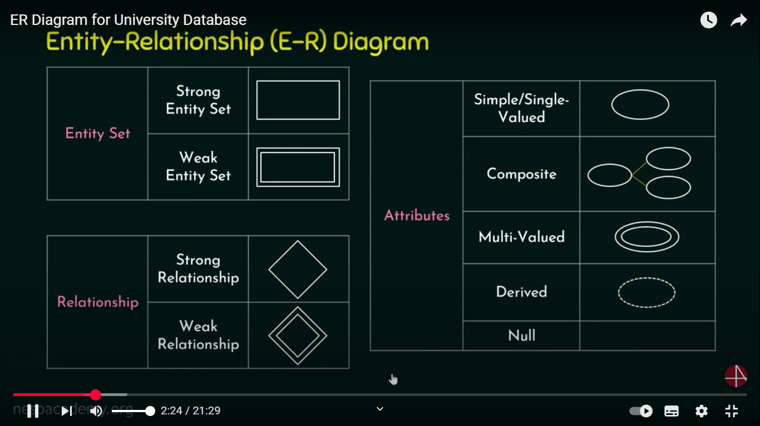

Slide 59
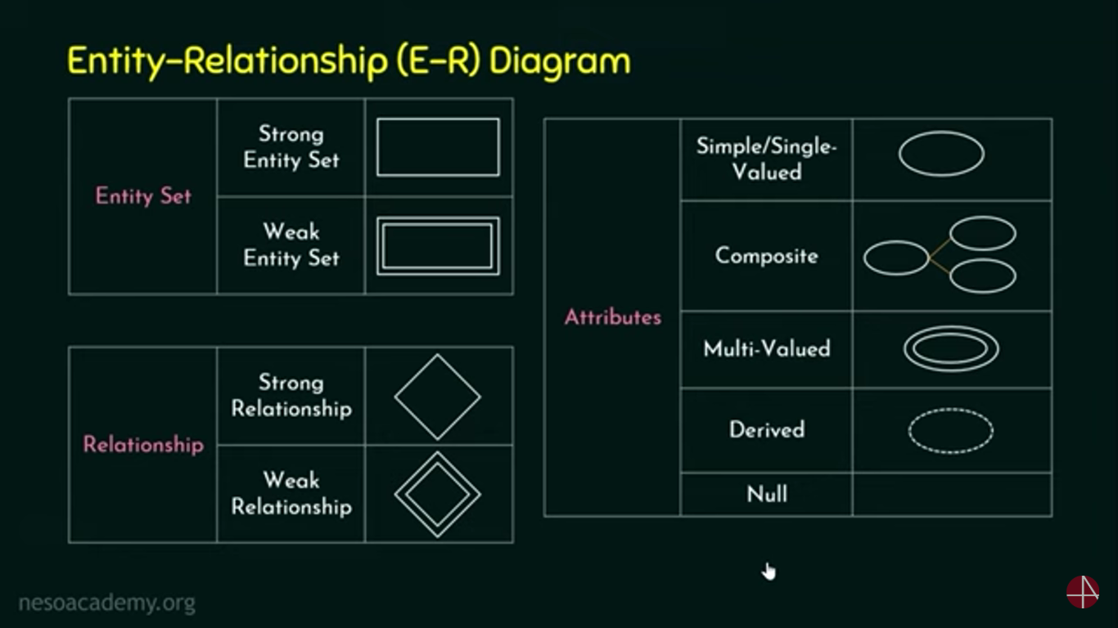

Slide 60
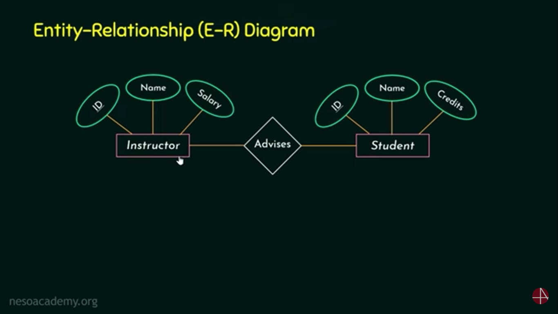

Slide 61
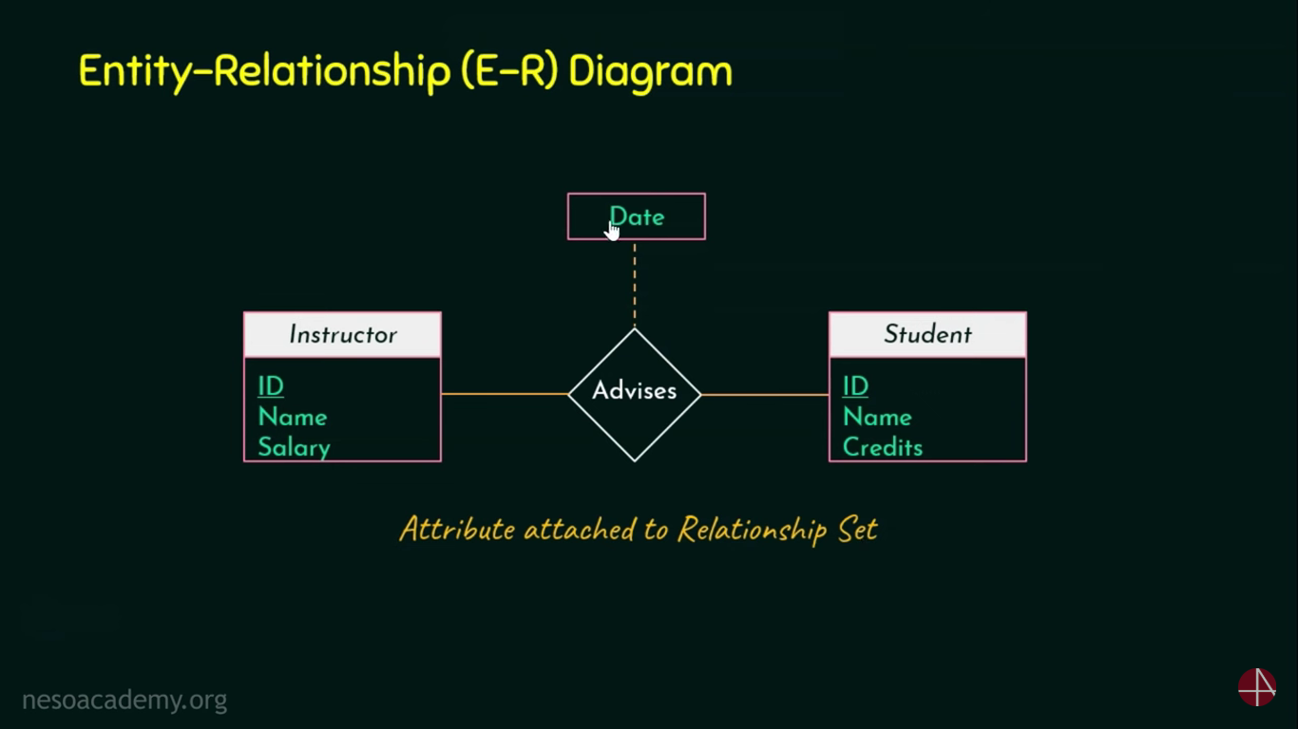

Slide 62

No PK in Section,Weak

Slide 63
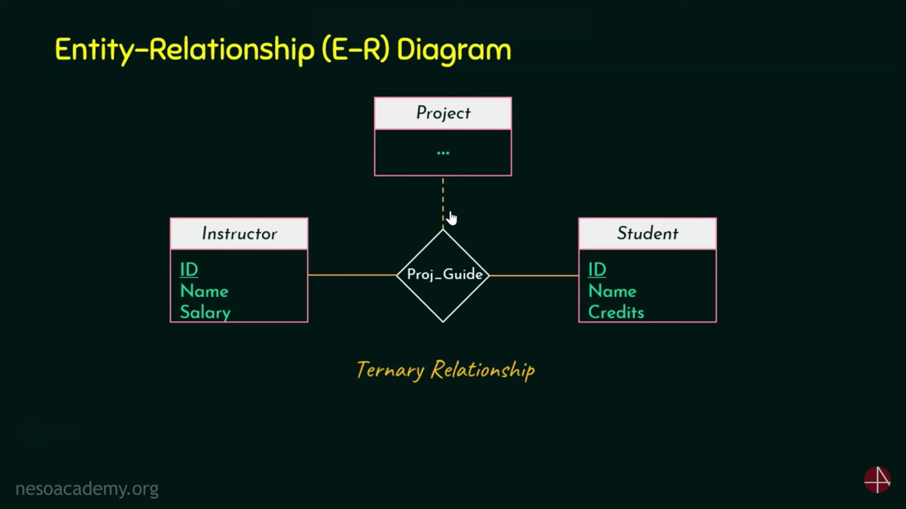
Dotted line (it exist bcoz other 2 exist)

Slide 64


Slide 65


Slide 66

1 Instructor can advise to many students(one to many)

Slide 68
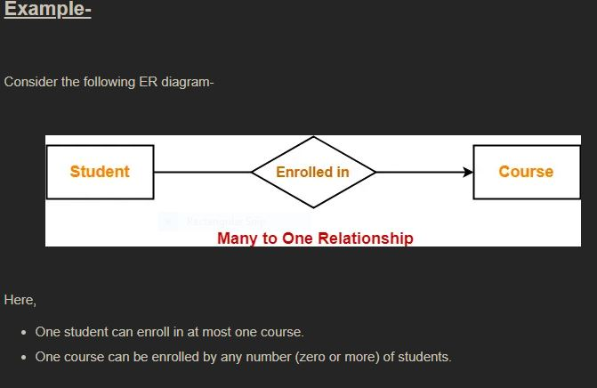
M:1

Slide 69
One to many

Slide 70

1:n

Slide 71
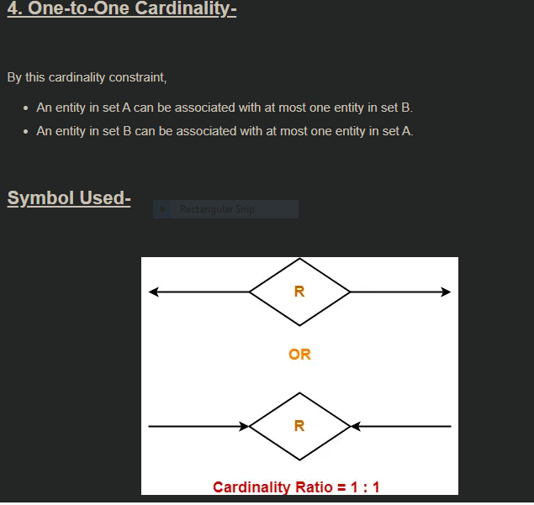
1:1

Slide 72
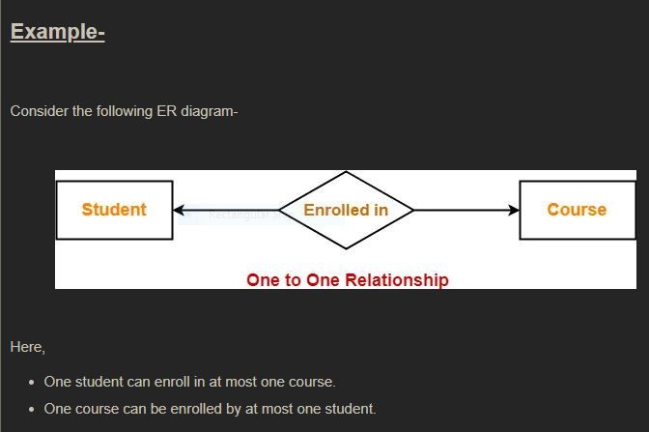

Slide 73
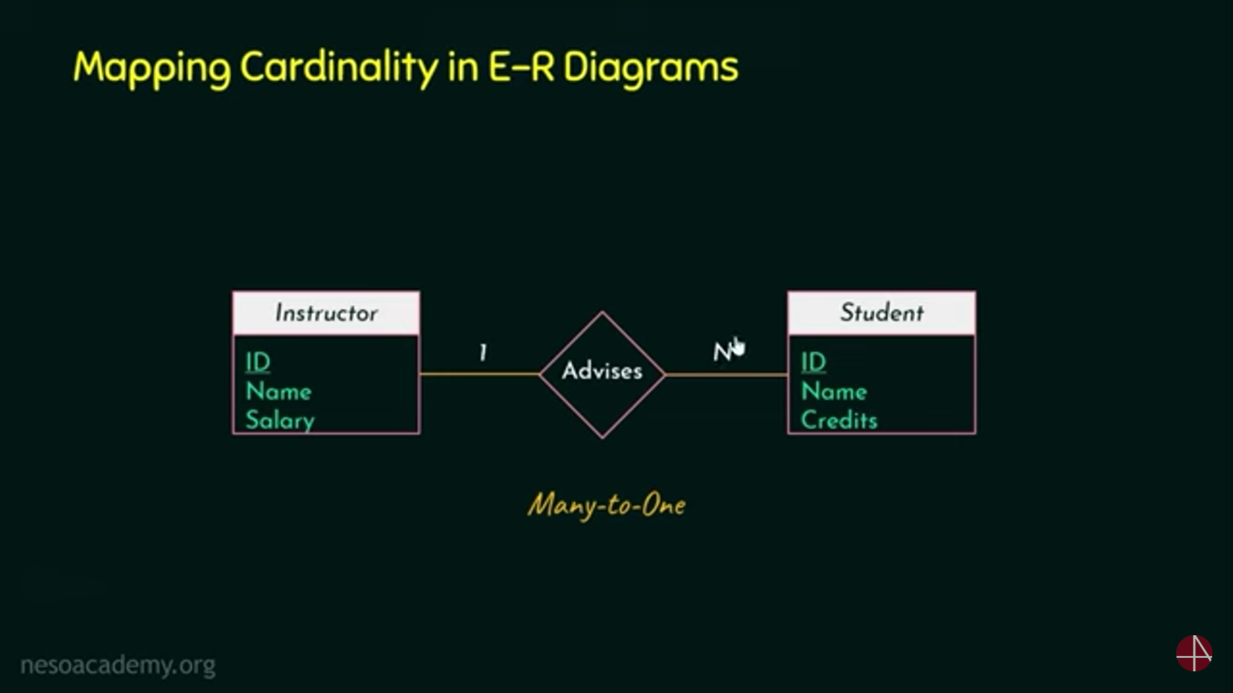

Slide 74
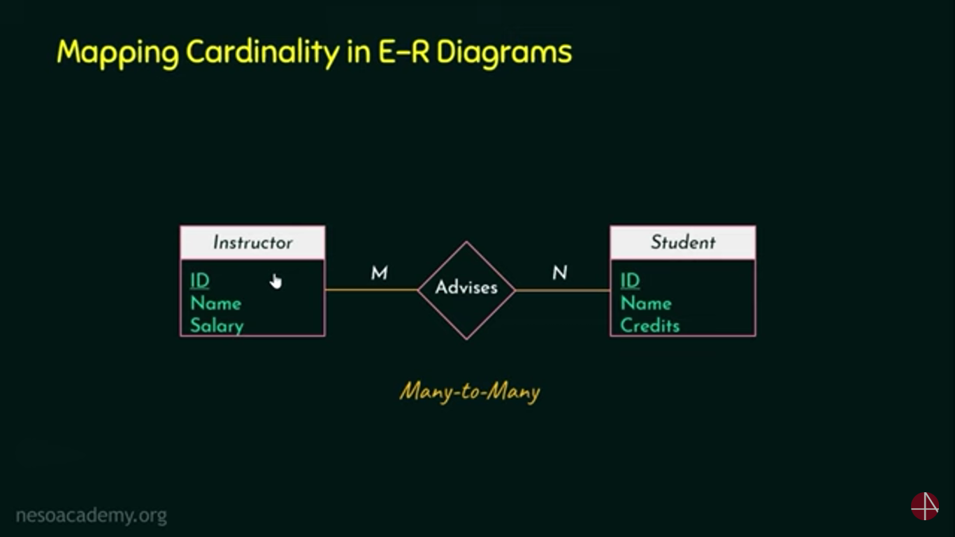

Slide 75
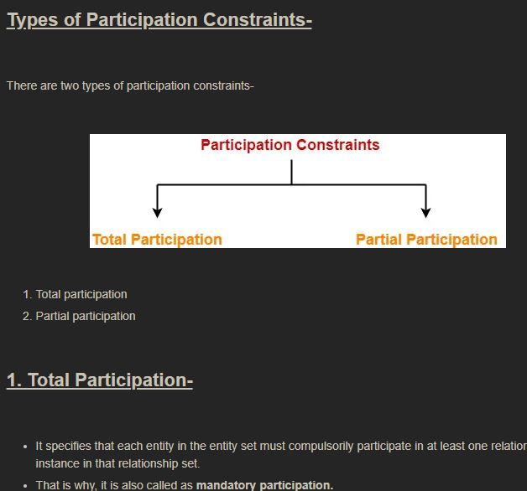

Slide 76
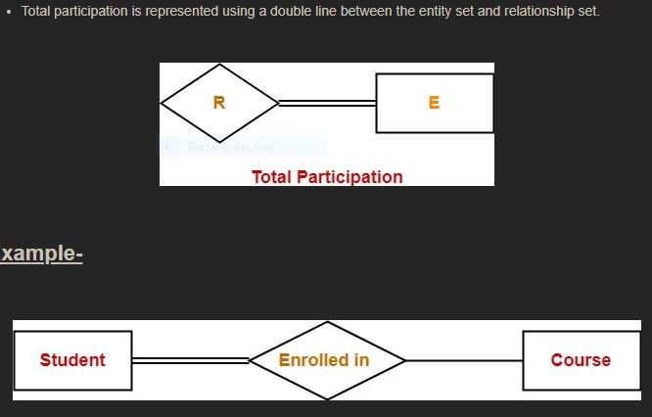
Here, Double line between the entity set “Student” and relationship set “Enrolled in” signifies total participation. It specifies that each student must be enrolled in at least one course.

Slide 77
2. Partial Participation-
It specifies that each entity in the entity set may or may not participate in the relationship instance in that relationship set.
That is why, it is also called as optional participation.
Partial participation is represented using a single line between the entity set and relationship set.

Slide 80
Here,
Single line between the entity set “Course” and relationship set “Enrolled in” signifies partial participation.
It specifies that there might exist some courses for which no enrollments are made.
Relationship between Cardinality and Participation Constraints-Minimum cardinality tells whether the participation is partial or total.
If minimum cardinality = 0, then it signifies partial participation.
If minimum cardinality = 1, then it signifies total participation.
Maximum cardinality tells the maximum number of entities that participates in a relationship set.

Slide 81
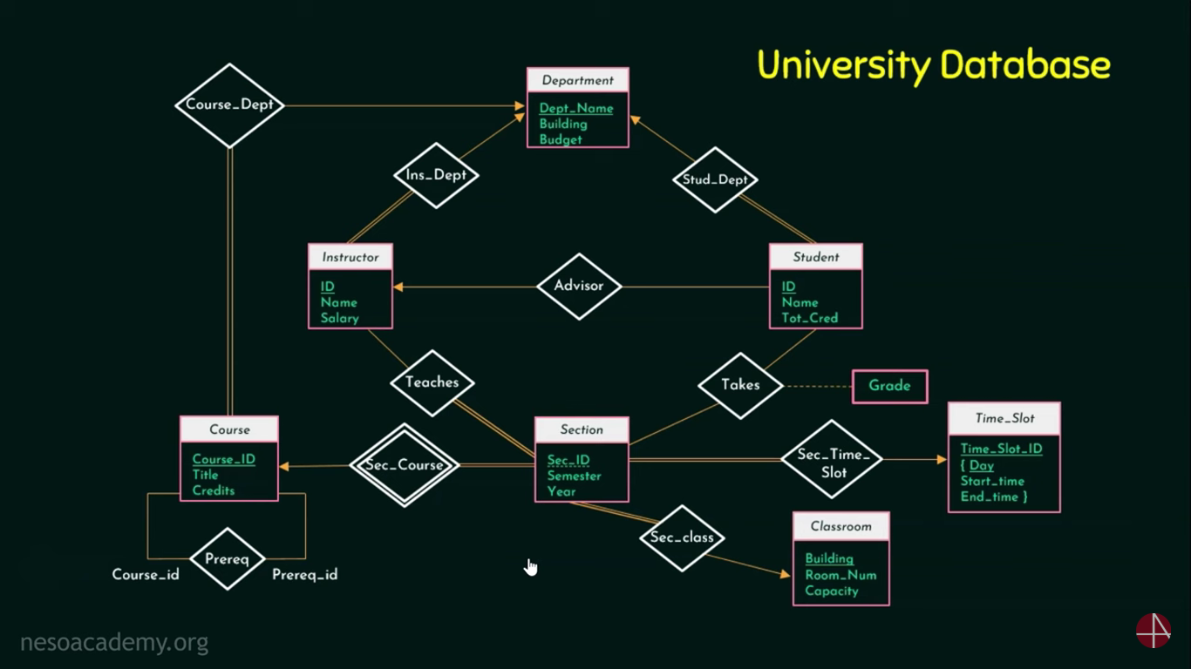

Slide 82
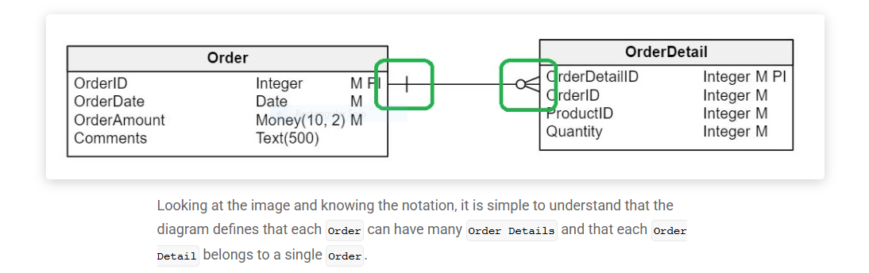

Slide 83
For a single LOAN Multiple Payment can be made.

Slide 84
How to Convert ER Diagrams to Tables in DBMS?
To convert ER diagrams to tables in a database management system (DBMS), follow the methods outlined below:
Step 1
Converting strong entities
Create a separate table with about the same name for each strong object.
If there is a composite attribute that has to be included, it must be separated into simple attributes.
At this point, ignore multivalued characteristics.
For the table, press the P key.
Step 2
Converting weak entity
Create a separate table with the very same name for each weak entity.
Include all attributes in your list.
The weak entity includes the P key of a strong entity as a foreign key.
Declare the weak entity’s P key as a combination of foreign key as well as decimator attribute.
Step 3
Converting one-to-one relationship
Modify either the A or B side of each one-to-one connection, say A and B, to add the P key of the opposite side as a foreign key.
If A or B has 100% participation, then the table should be modified.
Include attributes in the modified table if a relationship contains them.
Step 4
Converting one-to-many relationship
Modify the M side of each one-to-many relation to include the P key of one of the sides as a foreign key.
If your relationships have attributes, make sure to mention them as well.
Step 5
Converting many-to-many relationship
Create a new table for each many-to-many relationship, using the P key from the M side and the N side as foreign keys.
Declare P for the new table’s foreign key combination.
If your relationships have properties, insert those in the new table as well.
Step 6
Converting multivalued attributes
Create a separate table for each multivalued attribute and use the current table’s P key as a foreign key.
P keys are created by combining a foreign key and a multivalued attribute.
Step 7
Converting n-ary relationship
Create a separate table for each n-ary relationship and then include the P key of all the entities as a foreign key.
Declare the P key as a combination of foreign keys.

Slide 85
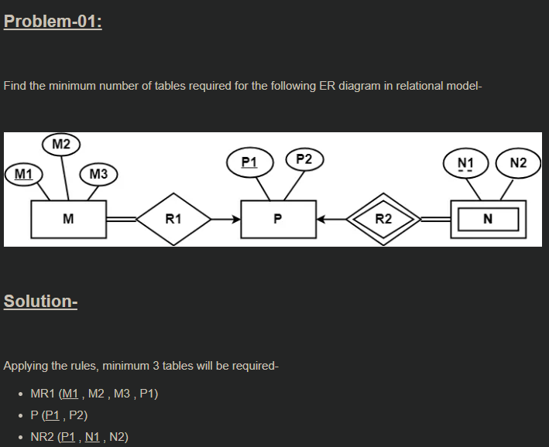
Ex-1

Slide 86
Problem-02:
Find the minimum number of tables required to represent the given ER diagram in relational model-

Slide 87
Ans:-Applying the rules, minimum 4 tables will be required-
AR1R2 (a1 , a2 , b1 , c1)
B (b1 , b2)
C (c1 , c2)
R3 (b1 , c1)

Slide 88
Problem-03:
Find the minimum number of tables required to represent the given ER diagram in relational model-

Slide 89
Solution-
Applying the rules, minimum 5 tables will be required-
BR1R4R5 (b1 , b2 , a1 , c1 , d1)
A (a1 , a2)
R2 (a1 , c1)
CR3 (c1 , c2 , d1)
D (d1 , d2)

Slide 90
Problem-04:
Find the minimum number of tables required to represent the given ER diagram in relational model-

Slide 91
Solution-
Applying the rules, minimum 3 tables will be required-
E1 (a1 , a2)
E2R1R2 (b1 , b2 , a1 , c1 , b3)
E3 (c1 , c2)

Slide 92
Problem-05:Find the minimum number of tables required to represent the given ER diagram in relational model-

Slide 93
Ans:-Applying the rules that we have learnt, minimum 6 tables will be required-
Account (Ac_no , Balance , b_name)
Branch (b_name , b_city , Assets)
Loan (L_no , Amt , b_name)
Borrower (C_name , L_no)
Customer (C_name , C_street , C_city)
Depositor (C_name , Ac_no)

Slide 94
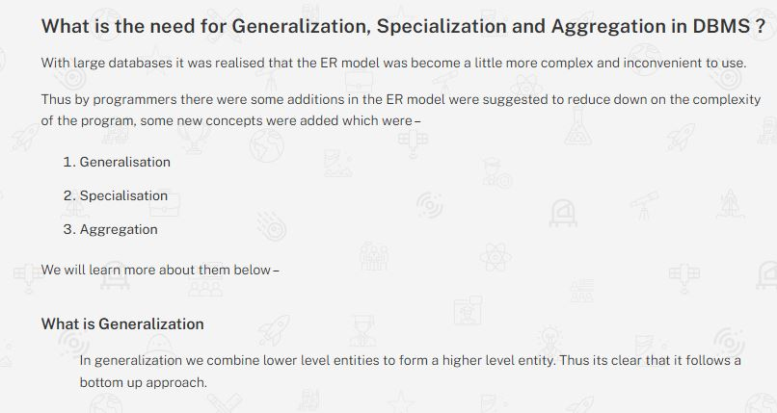

Slide 95
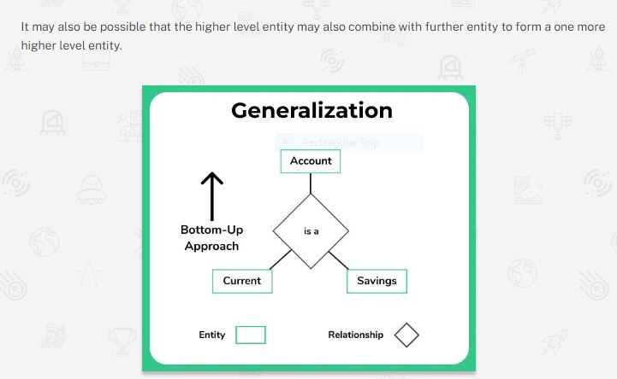

Slide 96
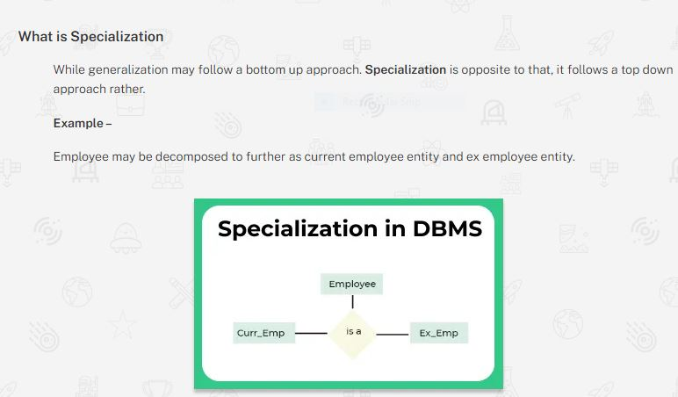

Slide 97
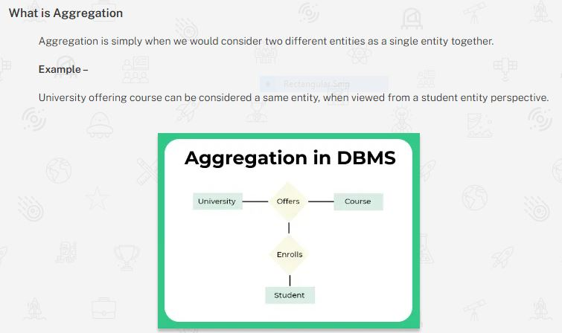

Slide 98
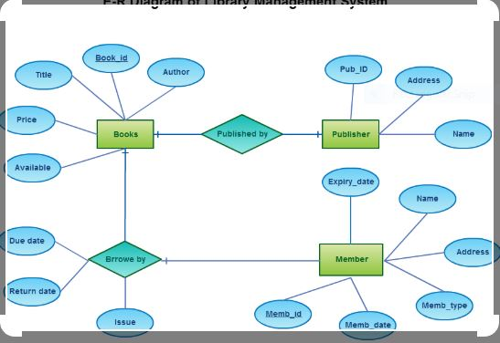
Ex

Slide 99
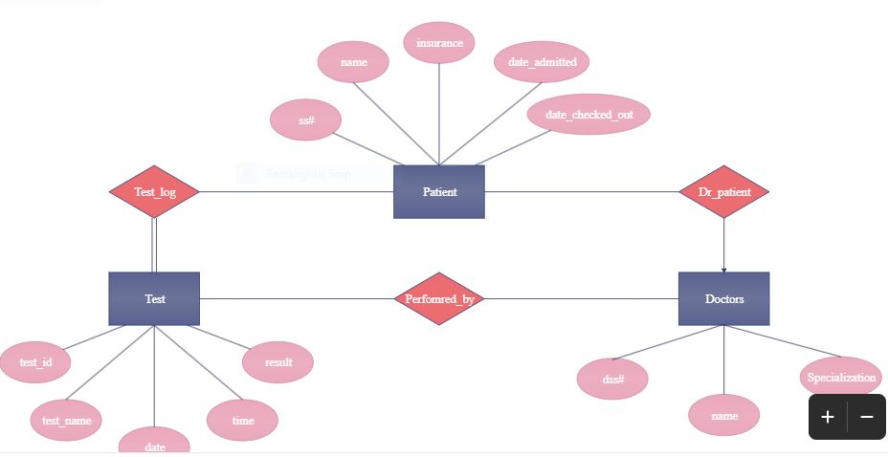
Ex-2

Slide 100
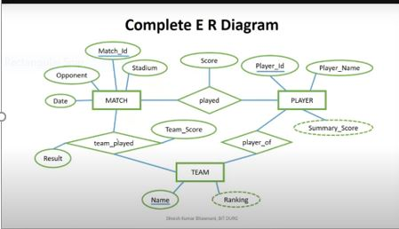

Slide 101
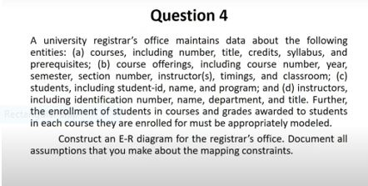

Slide 102
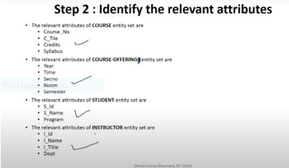

Slide 103


Slide 104
Keys In RDBMS
What are the different types of Keys in DBMS?
Keys are of seven broad types in DBMS:
Candidate Key
Primary Key
Foreign Key
Super Key
Alternate Key
Composite Key
Unique Key

Slide 105
1. Primary Key
The primary key refers to a column or a set of columns of a table that helps us identify all the records uniquely present in that table. A table can consist of just one primary key. Also, this primary key cannot consist of the same values reappearing/repeating for any of its rows. All the values of a primary key have to be different, and there should be no repetitions.
The PK (PRIMARY KEY) constraint that we put on a column/set of columns won’t allow these to have a null value or a duplicate. Any table can consist of only a single primary key constraint. A foreign key (explained below) that refers to it can never change the values present in the primary key.
2. Super Key
A super key refers to the set of all those keys that help us uniquely identify all the rows present in a table. It means that all of these columns present in a table that can identify the columns of that table uniquely act as the super keys.
A super key is a candidate key’s superset (candidate key has been explained below). We need to pick the primary key of any table from the super key’s set so as to make it the table’s identity attribute.

Slide 106
3. Candidate Key
The candidate keys refer to those attributes that identify rows uniquely in a table. In a table, we select the primary key from a candidate key. Thus, a candidate key has similar properties as that of the primary keys that we have explained above. In a table, there can be multiple candidate keys.
4. Alternate Key
As we have stated above, any table can consist of multiple choices for the primary key. But, it can only choose one. Thus, all those keys that did not become a primary key are known as alternate keys.
5. Foreign Key
We use a foreign key to establish relationships between two available tables. The foreign key would require every value present in a column/set of columns to match the referential table’s primary key. A foreign key helps us to maintain data as well as referential integrity.
6. Composite Key
The composite key refers to a set of multiple attributes that help us uniquely identify every tuple present in a table. The attributes present in a set may not be unique whenever we consider them separately. Thus, when we take them all together, it will ensure total uniqueness.
7. Unique Key
A unique key refers to a column/a set of columns that identify every record uniquely in a table. All the values in this key would have to be unique. Remember that a unique key is different from a primary key. It is because it is only capable of having one null value. A primary key, on the other hand, cannot have a null value.

Slide 107
What are Armstrong’s Axioms in DBMS?
Armstrong’s axioms, introduced by William W. Armstrong in 1974, are a set of inference rules utilized to deduce all the functional dependencies within a relational database. These rules, when applied to a set of functional dependencies denoted as F+, are both sound, ensuring that only dependencies within the closure set F are generated, and complete, meaning that applying these rules iteratively will derive all functional dependencies within the closure F+.

Slide 108
Types of Axioms
There are 3 types of Axioms:
Reflexivity Axiom: For a set of attributes A and a subset B of A, if B is a subset of A (B⊆A), then A→B. This axiom represents a trivial property where a set of attributes implies itself.
Augmentation Axiom: If A→B is true and Y is a set of attributes, then AY→BY is also true. This axiom demonstrates that adding attributes to dependencies does not alter the fundamental dependencies. If A→B holds, AC→BC holds for any set of attributes C.
Transitivity Axiom: If A→B holds and B→C holds, then A→C also holds, similar to the transitive rule in algebra. Functionally, it means that if A determines B and B determines C, then A determines C. If X→Y and Y→Z are true, then X→Z is also true.

Slide 109
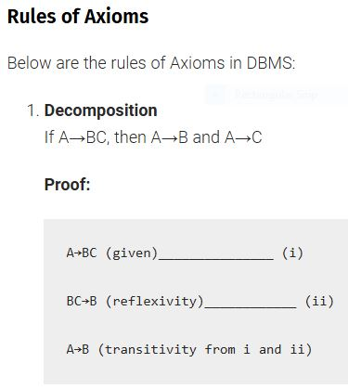

Slide 110
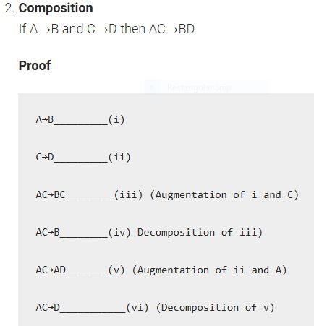


Slide 111
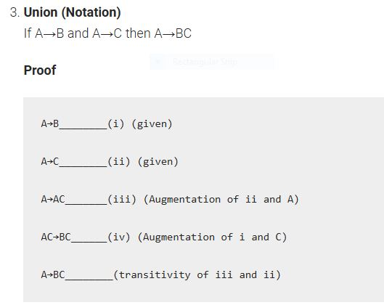

Slide 112
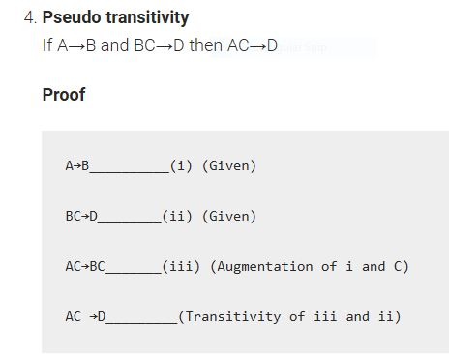

Slide 113
Contd..
Self-determination
A→A for any given A.
This rule directly follows the Axiom of Reflexivity.
Extensivity
Extensivity is a particular case of augmentation where C=A
If A→B, then A→AB
In the sense that augmentation can be proven from extensivity and other axioms, extensivity can replace augmentation as an axiom.
Proof
AC→A____(i)
A→B________(ii)
AC→B________(iii) (Transitivity of i and ii)
AC→ABC_______(iv) (Extensivity of iii)
ABC→BC______(v) (Reflexivity)
AC→BC (Transitivity of iv and v)

Slide 114
Q1. What is the significance of Armstrong’s axioms in DBMS? Armstrong’s axioms play a crucial role in the design, normalization, and analysis of relational databases. They provide a formal framework to identify and derive functional dependencies, which are essential for maintaining data integrity and designing efficient database schemas.
Q2. How are Armstrong’s axioms applied in DBMS? In DBMS, Armstrong’s axioms are used to infer additional functional dependencies from a given set of functional dependencies. By repeatedly applying the axioms, one can systematically derive all the dependencies that hold in the database schema.
Q3. Can Armstrong’s axioms generate incorrect dependencies? Armstrong’s axioms are sound, meaning that the dependencies they generate hold true in all valid relation states. However, if the initial set of functional dependencies is incorrect or incomplete, the derived dependencies may also be incorrect or incomplete.
Q4. Are Armstrong’s axioms limited to specific types of databases? No, Armstrong’s axioms are applicable to any relational database. They are independent of the specific database management system and can be used in the normalization and analysis of databases across different domains and industries.
Q5. Are there any limitations to the use of Armstrong’s axioms? One limitation of Armstrong’s axioms is that the size of the minimum Armstrong relation can grow exponentially with the number of attributes in the dependencies being considered. This can pose challenges in terms of storage requirements and computational complexity for large databases.
Q6. Are there any alternative methods to derive functional dependencies? Apart from Armstrong’s axioms, there are other methods to derive functional dependencies, such as the closure algorithm and the attribute closure method. These methods use different approaches but aim to achieve the same goal of identifying all the functional dependencies in a database schema.
Post navigation

